Slide 1
Saltwater Intrusion into Freshwater Coastal Aquifers
Lori Fomenko

Slide 3
Badon Ghyben-Herzberg Formula (late 1800s)
Reilly and Goodman, 1985
Notes:
Formula is oversimplified and assumes that the GW head at the water table is the same as that of the freshwater at the interface, implies no vertical head gradient (Dupuit assumption)

Slide 4
Hubbert (1940)
Freshwater head
Saltwater head
Vertical location of the interface (Z) based on position of each head along the interface
Reilly and Goodman, 1985
Notes:
Continuity of pressure in flow field must be maintained across the interface ← can be treated as B.S. that couples two separate flow fields. Define head for each fluid

Slide 5
The Sharp Interface and Zone of Dispersion
Equation used to plot interface (Cooper, 1959)
Reilly and Goodman, 1985
Notes:
Glover → Sharp Interface
Cooper → zone of dispersion and attempt to define mixing due to tidal fluctuations
Bear → dispersion, sharp interfaces and movement of interfaces

Slide 6
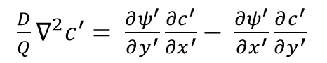
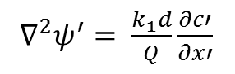
The Henry Saltwater Intrusion Problem (1964)
$∇^{2}ψ^{′}= \frac{k_{1}d}{Q}\frac{∂c′}{∂x′}$
Darcy’s equation with variable density
Boundary Conditions
$\frac{D}{Q}∇^{2}c^{′}= \frac{∂ψ^{′}}{∂y^{′}}\frac{∂c^{′}}{∂x^{′}}− \frac{∂ψ^{′}}{∂x^{′}}\frac{∂c^{′}}{∂y^{′}}$
Continuity Equation for salt and water
Reilly and Goodman, 1985
Notes:
Henry (1964) → 1st attempt to quantify effects of dispersion and density dependent fluid flow of saltwater intrusion into coastal aquifers. 2-D cross-section.
Use of the advection-diffusion equation (miscible fluids) instead of the sharp interface approach
Confined aquifer

Slide 7
2-D Advection-Dispersion Equation
Change in concentration due to hydrodynamic dispersion
Effects of advective transport of solutes in groundwater
Contribution and removal of solutes due to sources and sinks
C is the concentration of the dissolved solids
D is the hydrodynamic dispersion coefficient
V is the effective velocity of groundwater in the x direction
C’ is the concentration of dissolved solids in a source or sink
W is the general term for sources and sinks
D is the saturated thickness of the aquifer
Essink, 2001

Slide 8
Reilly and Goodman, 1985

Slide 9
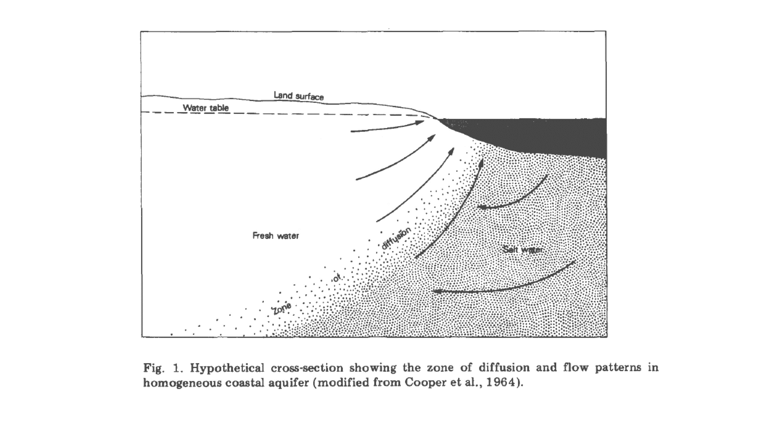

Slide 10
Reilly and Goodman, 1985

Slide 11
Essink, 2001

Slide 12
Notes:
World Cities Report, 2016
Urbanization and Development: Emerging Futures

Slide 13
Notes:
World Cities Report, 2016
Urbanization and Development: Emerging Futures

Slide 14
Notes:
World Cities Report, 2016
Urbanization and Development: Emerging Futures

Slide 15
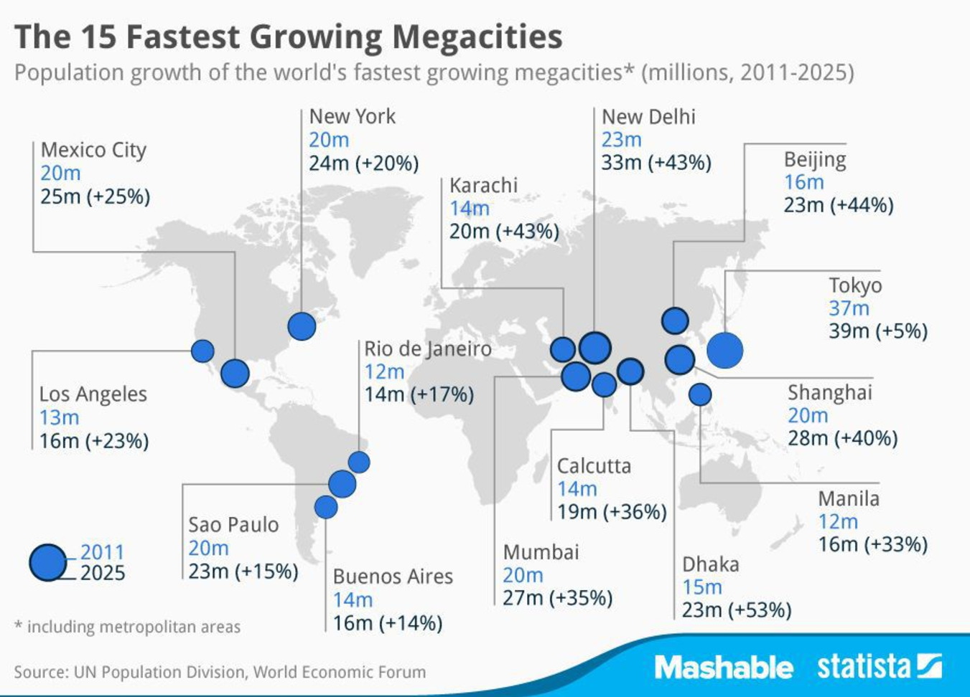

Slide 16
Essink, 2001

Slide 17
Nicholls & Cazenave, 2010
Notes:
Nicholls, Robert J., and Anny Cazenave. "Sea-level rise and its impact on coastal zones." science 328.5985 (2010): 1517-1520.

Slide 18
Nicholls & Cazenave, 2010

Slide 20
Questions?

Slide 21
Supplementary Information

Slide 22
Hydrodynamic dispersion
Hydrodynamic dispersion consists of:
Mechanical dispersion due to microscopic velocity variations, and
Molecular diffusion in the fluid due to concentration gradients and fluid/soil properties
Mechanical dispersion dominates under normal flow conditions
Very difficult to determine exactly due to dependency on:
Fingering
Transient effects
Aquifer heterogeneity
Anisotropy
Essink, 2001

Slide 24
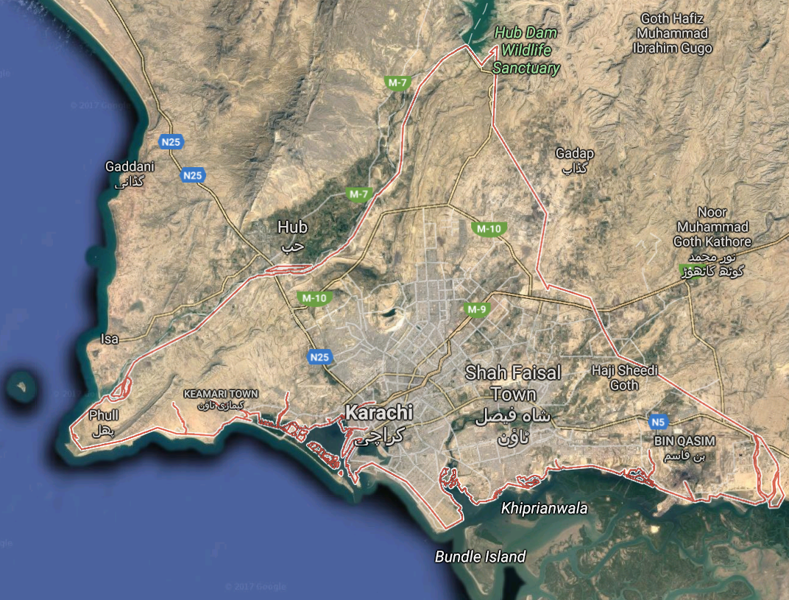
Notes:
Karachi

Slide 25
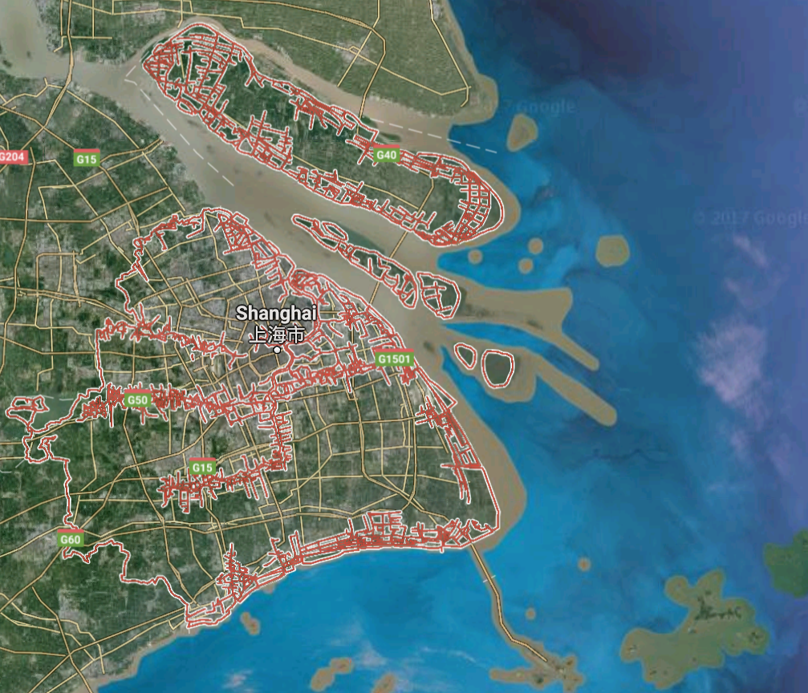

Slide 26
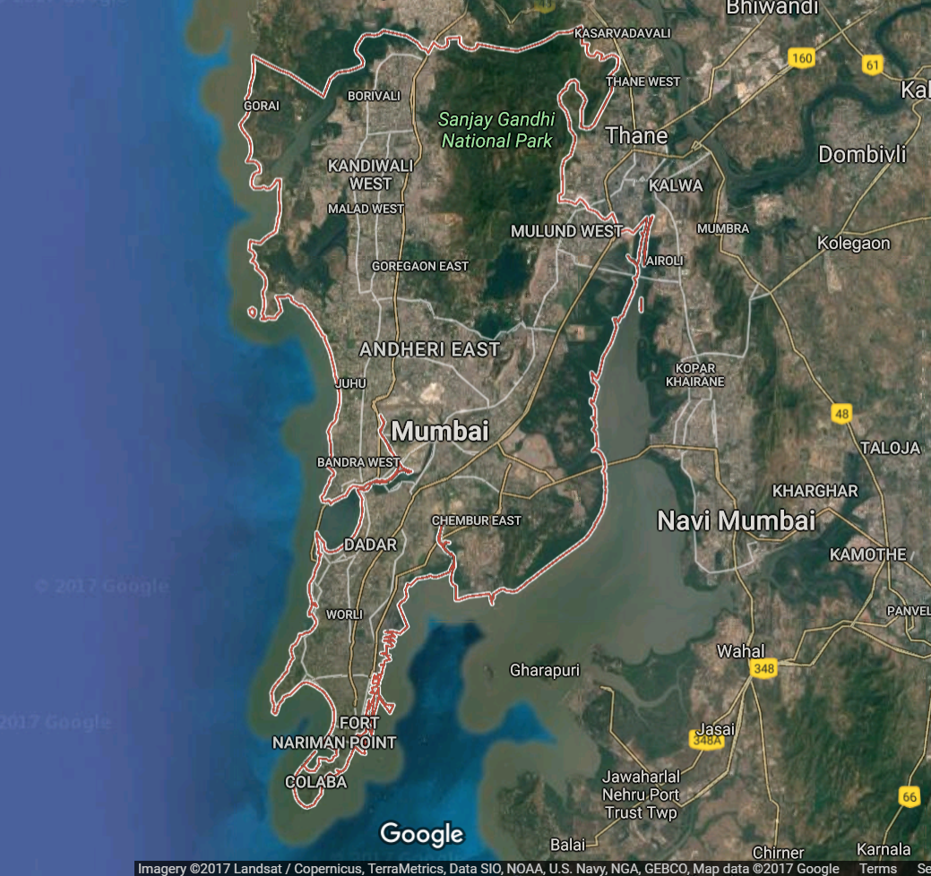

Slide 27
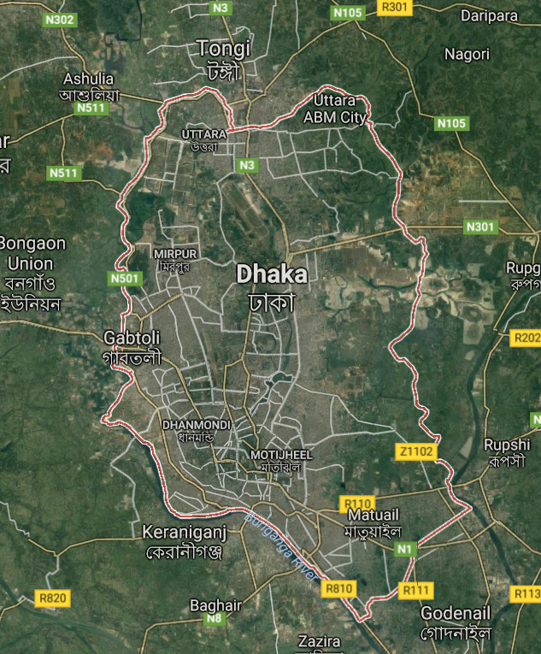

Slide 28
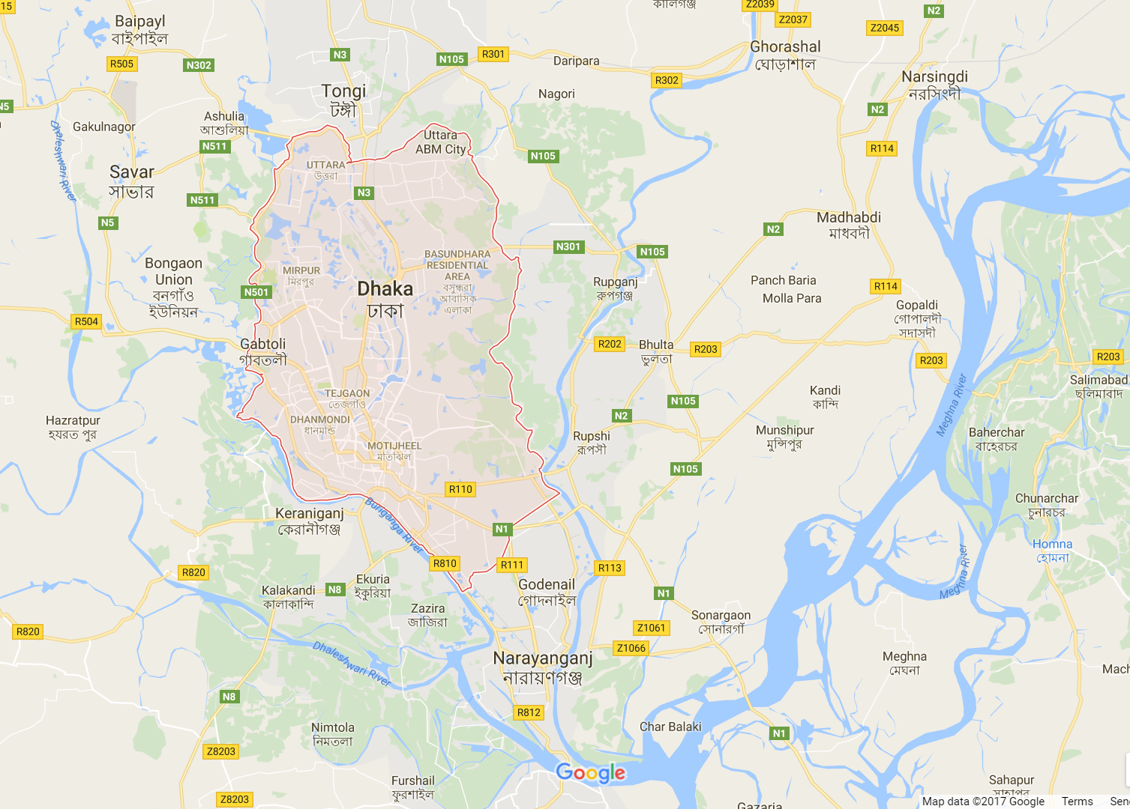

Slide 29
Notes:
World Cities Report, 2016
Urbanization and Development: Emerging Futures

